Slide 1
What is Sickle Cell Anemia???

Slide 2
Take a moment to think silently…
What questions would you ask to find the information you need?
How much information is enough to explain what sickle cell anemia is?

Slide 3
Brainstorm:
What is it?
What are the effects?
Is it curable? / What is the treatment?
How is the disease contracted?
Anything to avoid?
Is it fatal?

Slide 4
Brainstorm
Is it fatal?
How does one contract SCD?
What is it?
Is it contagious?
What lifestyle changes are needed, if any?
Treatment options?
What part of the body will be affected?
Will my kids get this? / Is it genetic?
How common is this?
What are some side effects/Susceptibility?

Slide 5
Brainstorm as a Class: 5th Hr. Questions
Share the questions you came up with:
Is it deadly?
What exactly can it affect??
What IS it?
What are the causes??***
Who is most at risk?
Can it be prevented??
Is it curable?? / Are there stages?
Is it contagious?
How common is it?
Is it hereditary??
Symptoms??
What abnormal about a sickle cell?
Notes:
If students come up with a question that corresponds to a later question, have them star it on their paper and hold on to it until later.

Slide 6
Brainstorm as a Class: 2nd Hr. Questions
Share the questions you came up with:
What causes sickle cell disease?****
What part of the body does it affect?
How is treated/can it be treated?
How does it start?
Is there a Cure?
Is it genetic?****
Is it contagious??
Is it fatal?
Who is most at risk??
How can spreading it be prevented??
What are the disadvantages of having this disease?
How do you get it?? ***
What are the symptoms?
What percentage of the population have this disease?
Notes:
If students come up with a question that corresponds to a later question, have them star it on their paper and hold on to it until later.

Slide 7
Information Stations
Read the articles to answer the questions you came up with
Be prepared to share what you’ve learned with the class

Slide 8
Sickle cell: Important info
The red blood cells become rigid, shaped like sickles
Cells block blood flow to all body parts
Problem with hemoglobin – forming clusters/rod, causing sickle shape of cell
Hemoglobin normally carries oxygen
RBCs dying off after 10-20 days, normally live 120, causes anemia
Tested with blood test – at the sickle cell foundation
No cure
Increasing life expectancy

Slide 9
Sickle cell: Important Info
Disease affects blood cells – RBCs
Caused by problems with the hemoglobin – molecule that binds oxygen
Forming rod-like structures
Blood cell stiff/rigid, causes sickle shape
Painful, “crises,” yellowing eyes, clogging vessels/blocks blood flow, prone to strokes, life threatening
Lowers blood cell count, shortened life span of RBCs, 10-20 days

Slide 10
Share Interesting/Important Info: 5th Hr
Affects about 72,000 americans
Symptoms can be treated
Red blood cell disorder
There can be clogging of blood vessels, sticking together, sickle shaped – makes cells hard and sticky
People of African descent, people of Hispanic background
Hemoglobin – mutated
Can be tested for it, blood test

Slide 11
Share Interesting/Important Info: 2nd Hr
Abnormal Hemoglobin
Causes blockage in your blood vessels
Red blood cells are “sticky” – sickle shape
Causes pain, damage, and low blood count
Yellow eyes, blood cells can’t carry enough oxygen
Sickle cells only live 10-20 days – normal live 120 days
Infants and young children affected most severely
Common in people along the equator
No cure, can treat some of the symptoms and side effects
Not contagious

Slide 12
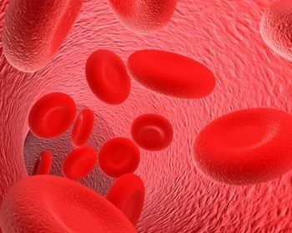

Slide 13
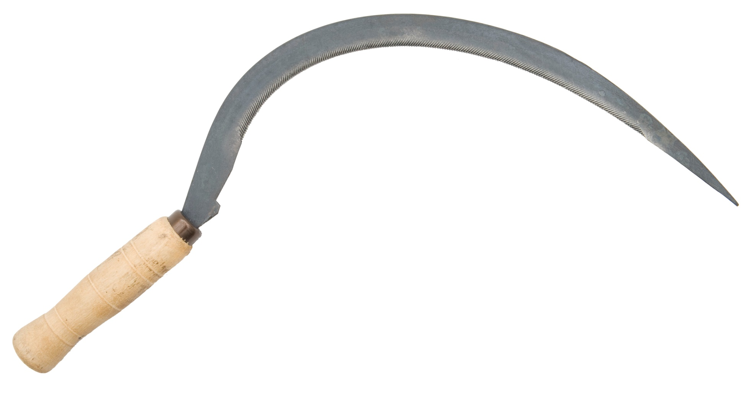
This is a sickle tool

Slide 14
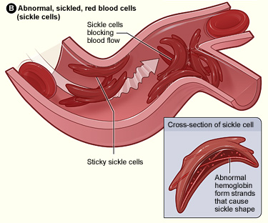

Slide 15
Hemoglobin
Hemoglobin is a protein in your blood that carries oxygen around the body
More hemoglobin = More oxygen = Longer, stronger workouts/activity (Blood doping??)
Not enough hemoglobin = Not enough oxygen = Weak, quick to fatigue

Slide 16
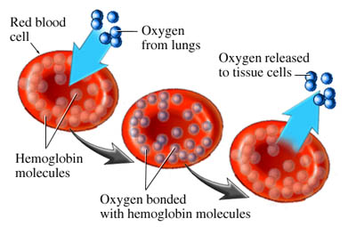
Hemoglobin
Normally, hemoglobin forms nice round structures that fit nicely into your blood cells (kind of like a bean bag chair)
← See nice round shape?

Slide 17
Molecular structure of normal hemoglobin protein
Should be round and free floating

Slide 18
Hemoglobin
BUT – In patients with sickle cell anemia, something goes wrong with their hemoglobin causing it to form sharp, stick like structures called fibers (Think of putting pencils in a rubber balloon)
This reduces protein’s ability to hold on to oxygen and also gives the blood cell the “sickle” shape causing it to clog up blood vessels

Slide 19
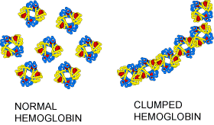
The hemoglobin forms these fibers because the molecules get “sticky” and begin to clump together (Right)

Slide 20
Conclusion: What is sickle cell anemia?
In your notes, use the information you have to answer this question to the best of your ability. Be as specific as possible.

Slide 21
What causes sickle cell anemia?

Slide 22
Things we know:
Student responses here

Slide 23
Brainstorm: Causes of Disease/Illness

Slide 24
Brainstorm: Causes of diseases/ disorders
Try to think of everything you know that might cause an illness/disease/disorder
Genetics/inheritance
Level of diet/exercise
Bacterial infection
Blood loss – trauma
Abnormal chemical/hormone/etc levels
Unprotected sex – Viral, Bacterial, parasites/ticks
Environment – contamination/pollution/radiation
Random chance??
Medical malpractice – bad diagnosis/bad prescription/wrong blood during transfusion
Insects
Notes:
Bacteria, Virus, fungus, genetics, parasites, pollution/chemicals/environment

Slide 25
Brainstorm: Causes of diseases/ disorders – 5th Hr
Try to think of everything you know that might cause an illness/disease/disorder
Genetics – hereditary diseases, mutation of DNA
Environment – UV radiation/sun, pollution, temp
Infections – bacteria in cuts/ingested, fungus, viruses
Carcinogens/cancer
Weak immune system – low white blood cells
Medications – side effects
Level of exercise
Allergies
Chemicals – accidental exposure/or other
Nutrition/unbalanced diet
Notes:
Bacteria, Virus, fungus, genetics, parasites, pollution/chemicals/environment

Slide 26
Brainstorm: Causes of diseases/ disorders – 2nd hr
Try to think of everything you know that might cause an illness/disease/disorder
Hereditary – genetic
Brain damage
Virus
Bacteria
Radiation
Parasites
Medicine/substance – side effects
Addiction – illegal substances
Diet, activity level
Weather, environment
Fungus
Poisions/chemicals – carbon monoxide, snake venom
Notes:
Bacteria, Virus, fungus, genetics, parasites, pollution/chemicals/environment

Slide 27
Brainstorm: Narrow it down
Using the list of possible causes, think of how we could test and rule out each option (Anyone watch “House”?)
Gender
Age
Surgery
Environment – local environment, regional
Detailed family history
Check for points of infection
Race
MRI/xray
Blood tests
Lumbar punctures and biopsies
Medication
Medical background/history
Substance use

Slide 28
Brainstorm: Narrow it down – 5th Hr
Using the list of possible causes, think of how we could test and rule out each option (Anyone watch “House”?)
Analyze symptoms/look them up
Check travel record/background
Blood tests – substances, blood count red or white
Examine parents – family background
Medication list
Food history/exposure
Body search
Antibiotics/antifungal/antihistamines
Xrays/CAT scans/MRIs
Surgery
Treatment/see a specialist

Slide 29
Brainstorm: Narrow it down – 2nd Hr
Using the list of possible causes, think of how we could test and rule out each option (Anyone watch “House”?)
CAT scan, MRI, xray
Blood test
Urine test
Medicine – antibiotics, antifungal, shots,
Genetics – family history, blood test – DNA
Weather

Slide 30
Final Hypothesis:
I think that sickle cell disease is caused by_______________
I could test this by…

Slide 31
Information Stations
Use information around the room to find out what causes this disease
Take notes to help you remember the details
Once you are finished, you will be asked to share what you have learned

Slide 32
What did you find out?
Go back to your hypothesis – was it proven or disproven?

Slide 33
What did you find out?
Go back to your hypothesis – was it proven or disproven?
HBB – HemogloBin Beta - GENE
Chromosome 11 – DNA – holds instructions/GENES
Gene is made incorrectly/defective
If parents have it – increases chance offspring will have it
Abnormal protein is causing HB clumping – sickle cells

Slide 34
Video Clip
Sickle Cell

Slide 35
What we need to know to understand this mutation:
What is DNA made of?
How is DNA copied, read, and turned into proteins?
What happens if something goes wrong?

Slide 36
The History of DNA
1800s – Gregor Mendel worked pea traits but didn’t quite know what these “factors” were
1928 – Frederick Griffith does an experiment with strains of bacteria. He concludes “something” is being transferred between the strains to make them both fatal. Scientists at the time believed it was a protein being transferred
1944 – Oswald Avery continues Griffith’s work and discovers it is NOT a protein, but actually DNA being transferred (not all scientists believe it yet)

Slide 37
History of DNA - continued
After the 1940s, DNA became a hot topic for research
1952 – Alfred Hershey and Martha Chase CONFIRM that DNA is the genetic material. They used viruses to show that DNA was being transferred but protein was NOT.

Slide 38
So we know DNA is important, but how does it work????!
In science, a common step to understanding the function of something is to study its STRUCTURE

Slide 39
The Structure of DNA
Section 8.2 in Textbook

Slide 40
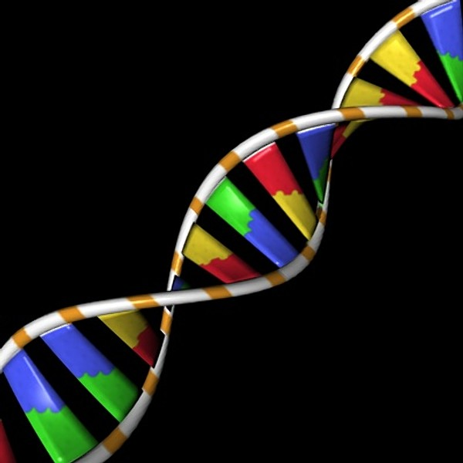
Structure of DNA
We’ve talked about DNA being in a “double helix” or “twisted ladder” shape

Slide 41
Structure of DNA
That double helix shape is actually composed of billions and billions of smaller building blocks

Slide 42
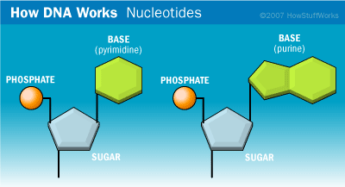
Structure of DNA
DNA = DeoxyriboNucleic Acid
DNA is the product of billions of Nucleotides stuck together

Slide 43
Nucleotides
Nucleotides consist of 3 very important parts:
Sugar
Phosphate
And a nitrogen base

Slide 44
Nucleotides: The Nitrogen Base
Notice the two kinds of nitrogen containing, or nitrogenous, bases – there are TWO types
One has two rings = PURINES
The other has one ring = PYRIMIDINES

Slide 45
Building DNA
The way these nucleotide bases fit together is what determines this genetic code we have been talking about
The ENTIRE code only consists of 4 bases
Guanine and Adenine are PURINES
Thymine and Cytosine are PYRIMIDINES
OPPOSITES ATTRACT → Guanine always pairs with Cytosine, and Thymine always pairs with Adenine
Or → ****G-C and T-A****

Slide 46
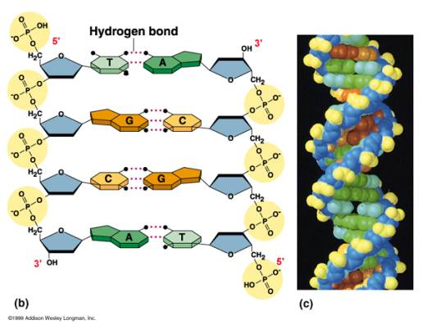
Building DNA
Notice how the base pairs are fitting together**
The dotted lines are hydrogen bonds

Slide 47
Building DNA
Notice how the sugars and phosphates fit together – this is called the “DNA backbone”
Also notice that the two strands run in OPPOSITE directions. This is called “antiparallel”

Slide 48
The DNA code
The arrangement of Cs, Gs, Ts, and As may seem random and nonsensical to us – but this is what the cell uses as instructions for EVERYTHING

Slide 49
Building DNA
Video

Slide 50
Now it is your turn to build DNA!!
Remember:
DNA is a “twisted ladder” shape
A DNA molecule is built by billions of nucleotides stuck together
A nucleotide contains 3 important parts: deoxyribose (sugar), a phosphate group, and a nitrogenous base
G pairs with C
A pairs with T

Slide 51
DNA Replication
Section 8.3 in Textbook

Slide 52
When does DNA need to replicate??
Remember: Replicate means COPY
Video

Slide 53
DNA Replication
Before the cell divides, it needs to make an extra set of DNA to put in the new cell
In order to do this, the cell needs to use a whole TEAM of proteins!!
Proteins are responsible for basically every task within the cell!!
Cell shape, organization, waste clean up, receiving signals from outside the cell, **carry oxygen in the blood** – there is a protein custom made for almost every job
Proteins come in all shapes and sizes depending on the job it has to do

Slide 54
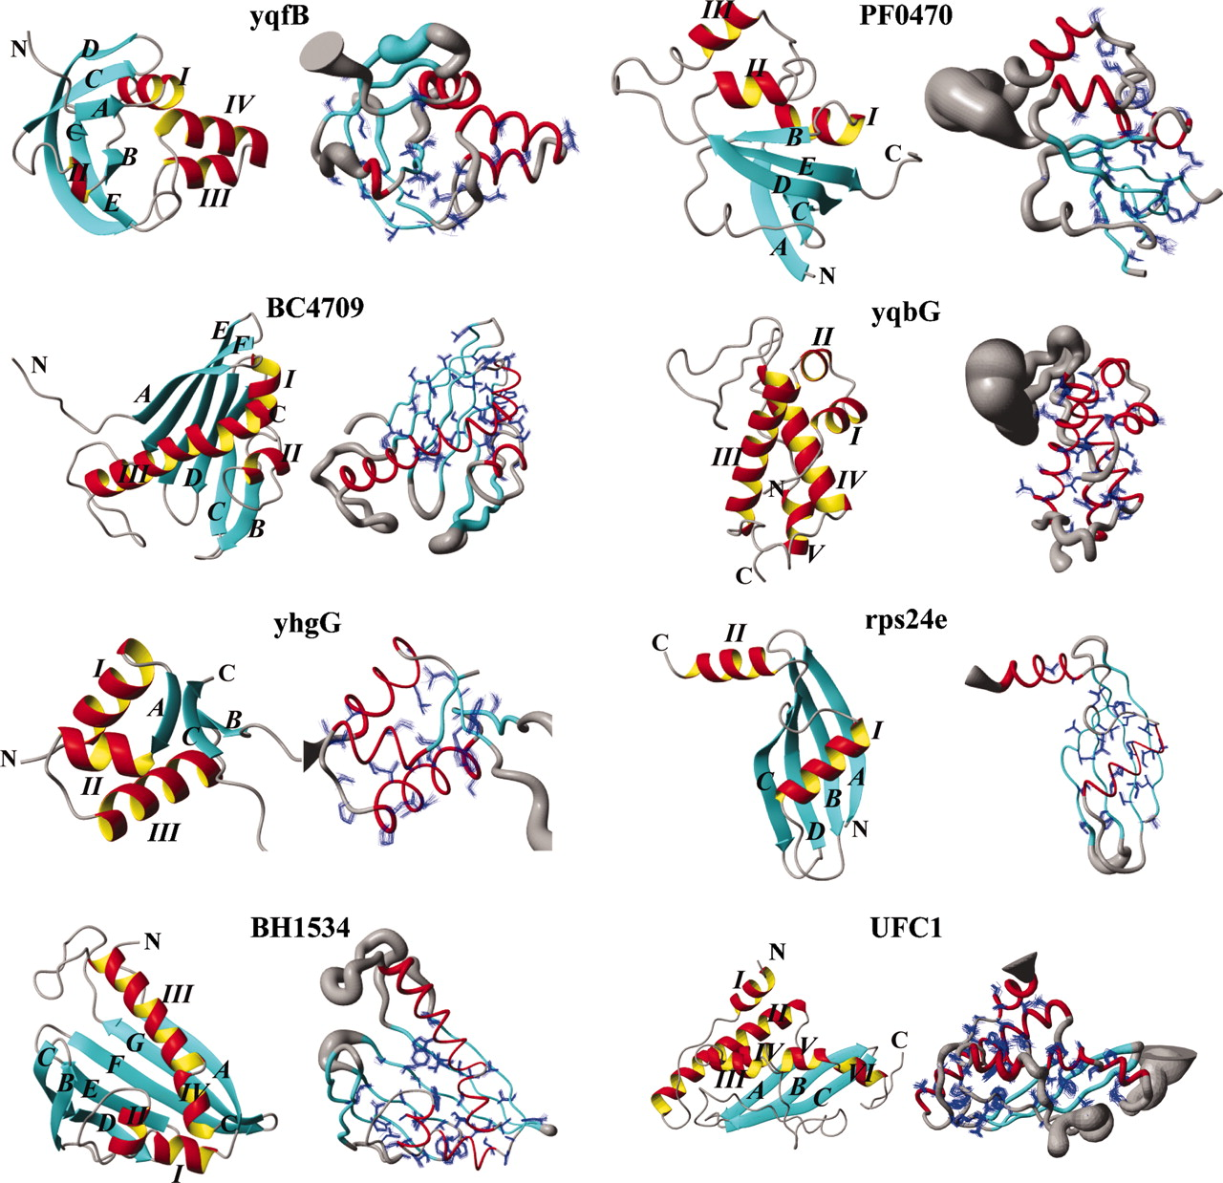
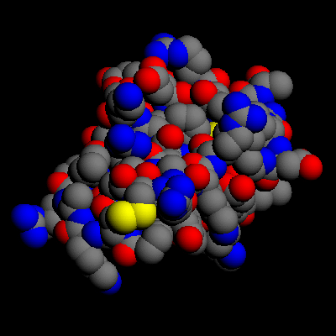
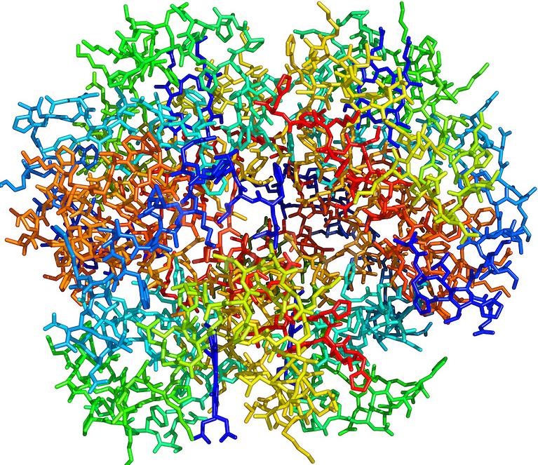
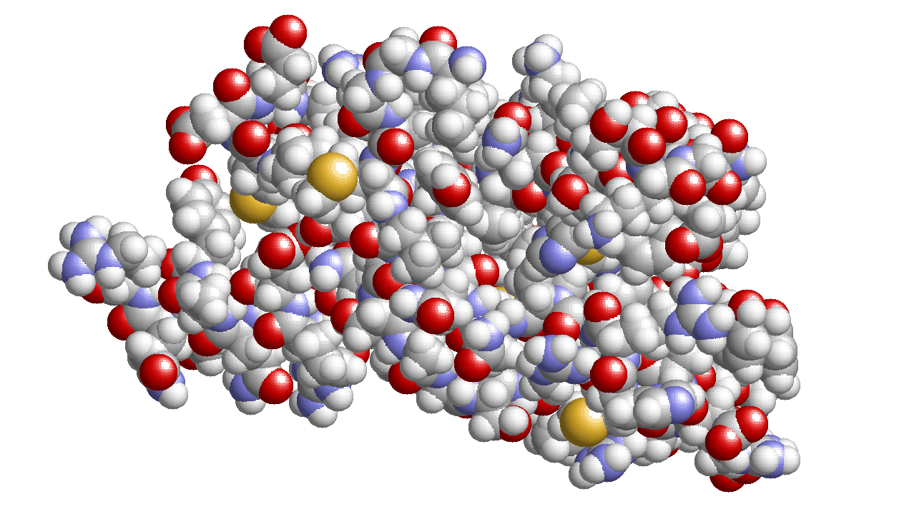
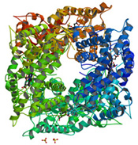
Proteins

Slide 55
DNA Replication Proteins
These are proteins that are involved with DNA replication – 49!!!
We will only talk about a couple of these…
Helicase – an enzyme that separates, or “unzips,” strands so replication proteins can access code
DNA polymerase – the building protein, this is doing the actual replication

Slide 56
Replication video
Video

Slide 57
DNA Replication
Page 223
1st – Strand is separated, unzipped
2nd – DNA polymerase uses each old strand as a guide/template to build a new half
Since G only pairs with C, and T only pairs with A – Polymerase should know exactly which bases to add
This will result in 2 identical strands of DNA

Slide 58
Replication Game!!!
This is tricky!
Easier: http://www.pbs.org/wgbh/aso/tryit/dna/

Slide 59
Replication can only make copies…
The cell uses different processes to make new products from the DNA code
These processes are called transcription and translation

Slide 60
DNA Transcription
Section 8.4 in Textbook

Slide 61
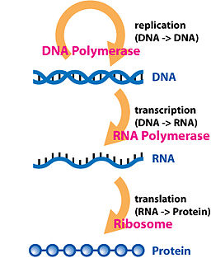
The Central Dogma
Fancy name for saying:
Replication copies DNA
Transcription makes RNA from DNA
Translation makes Protein from RNA
In pink are the key proteins in each process

Slide 62
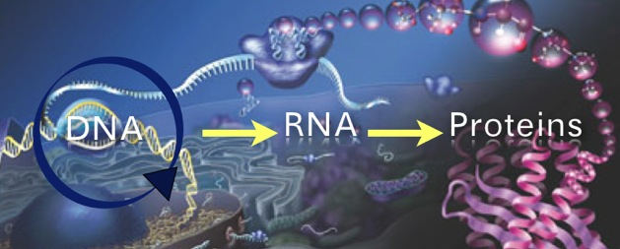

Slide 63
Transcription
Transcription is different from replication because it isn’t just making copies
Instead, it is making a new molecule called RNA

Slide 64
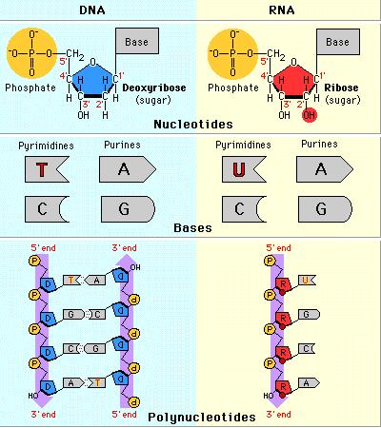
RNA
RNA stands for Ribonucleic Acid
It is very similar to DNA but has a few MAJOR differences
Ribose has an extra oxygen
Single strand
Uses URACIL instead of THYMINE

Slide 66
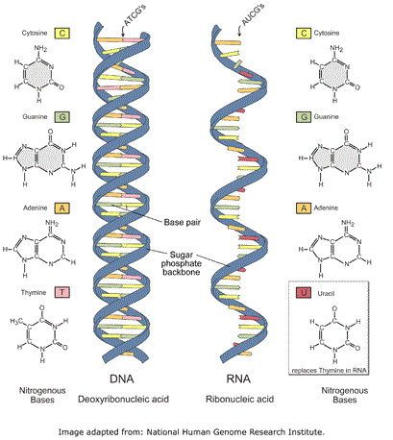

Slide 67
Why do organisms need RNA?
RNA can have different functions in the cell
mRNA – messenger RNA, brings segments genetic code to ribosomes to make whatever the gene says. It is a messenger just like the name implies
rRNA – ribosomal RNA, makes up parts of a ribosome which is important for making proteins
tRNA – transfer RNA, is responsible for bringing amino acids to the ribosome and locking them in place when a protein is being built

Slide 68
Transcription
This process creates all of the RNA types mentioned in the previous slide
Just like replication – transcription also uses several proteins to create RNA
RNA polymerase is the key protein that builds the RNA
Video

Slide 69
Translation
Section 8.5 in Textbook

Slide 70
Translation
Once the cell finishes transcription and makes mRNA, that mRNA can be sent to the ribosome to make proteins!
We can think of this as the ribosome reading mRNA and translating it into another “language” – amino acids
Amino acids get linked together to form proteins

Slide 71
RNA codons
Every set of 3 bases on RNA is called a CODON
Each codon represents an amino acid
The ribosome can read these codons like a recipe and will build the correct protein

Slide 72
Using the cookbook example:
If we think of DNA as a cookbook
RNA is the specific recipe
GENE is the specific recipe
RNA is the recipe CARD
Nucleotide bases are letters
Codons are the words that can be read
Amino acids are the ingredients
And proteins are the final product/meal

Slide 73
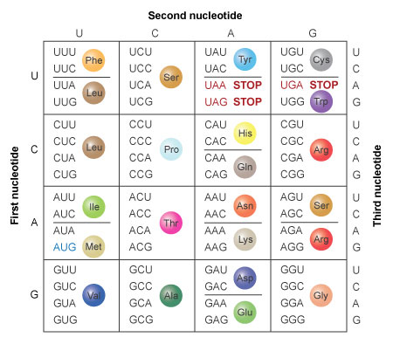
Codons and Amino Acids

Slide 74
Amino Acids
Amino acids are molecules that ALWAYS contain carbon, oxygen, and nitrogen
There are 20 different amino acids – different amino acids have different “behavior”
Polar/non-polar
Charged/uncharged
These affect how the protein will function once it has been made
Some amino acids contain sulfur and selenium

Slide 75
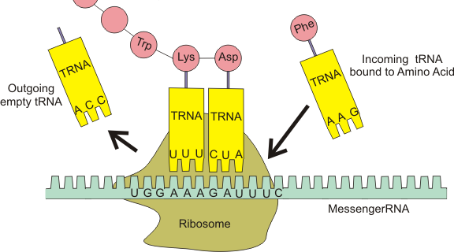
Translation
Translation occurs in the ribosome
We call ribosomes “molecular machinery” because it is their job to build proteins
Ribosomes are made of 2 main pieces of protein
One piece is the mRNA reader, the other piece is the amino acid linker

Slide 76
Translation
Translation occurs in 3 main phases
Initiation – All of the “machinery” gets into place
Elongation – tRNA carries amino acids to the ribosome to be linked into place
Termination – When a stop codon is hit, the machinery stops reading and falls away until it is needed again

Slide 77
Translation: Initiation
1st: The mRNA binds to the reader piece of the ribosome
2nd: tRNA carrying methionine binds its ANTICODON to the start codon on mRNA
3rd: The big piece of the ribosome (the linker) binds to both the tRNA and the smaller reading piece
Now the ribosome machinery is ready to start linking amino acids to form protein!

Slide 78
Translation

Slide 79
Elongation
To elongate something means “to make it longer”
This is what is happening with the amino acids
As the mRNA is read by the ribosome, tRNA molecules keep bringing the matching amino acids to be added to the chain

Slide 80
Termination
To terminate means “to end”
Once the gene coded for on the mRNA strand is finished, a stop codon signals a release factor which causes the machinery to fall away until it is needed again
The end product is a protein like hemoglobin!
Watch the whole process here:Video

Slide 81
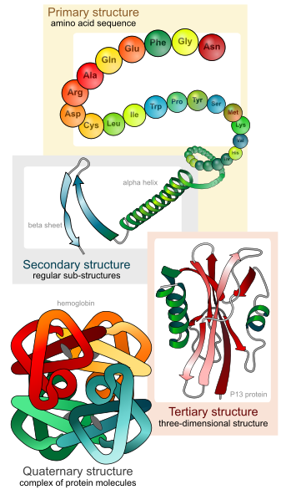
Protein Structure
Characteristics of amino acids determine structure of protein
Structure of protein determines FUNCTION of protein

Slide 82
Human Genome Project
Completed in 2003 – took 13 years
Entire human genome “decoded”
All 3 billion bases and 25,000 genes – locations and function
Why?
Process
Implications

Slide 83
MUTATIONS!
Section 8.7 in Textbook

Slide 84
The body isn’t perfect…
Sometimes mistakes are made during replication, transcription, or translation
Your DNA has billions of base pairs and over 20,000 genes to read
If even one nucleotide base is misplaced, this is called a genetic mutation

Slide 85
The good, the bad, the ugly…
Genetic mutations aren’t always bad – some can actually benefit the organism by creating a protein that actually works BETTER than the original
Introduces genetic variation
Some mutations have no effect at all – remember that more than one combination of nucleotides can code for the same amino acid

Slide 86
Mutations and Proteins
Remember: Amino acids are the ingredients for making proteins
If a mutations changes the function or amount of a protein it will no longer be able to do its job

Slide 87
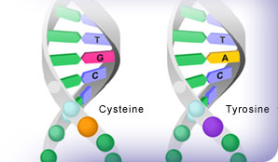
Types of mutations
Substitution mutations – this is where a section of gene is REPLACED with a piece that shouldn’t be there.
When a single base switches it is called a POINT MUTATION

Slide 88
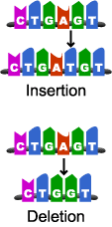
Types of Mutations
Insertion – a gene gets an extra nucleotide or several nucleotides, these can be a single base or even an entire gene
Deletion – a piece of DNA is lost, this can be a single nucleotide or even the entire gene

Slide 89
Types of mutations
Frameshift – this can be especially dangerous. Normally, the ribosome starts with MET and reads 3 bases at a time
If something causes the ribosome to lose its reading frame the protein may no longer make sense
Ex: the fat cat ate the rat → t hef atc ata tet her at

Slide 90
Predict: What type of mutation causes sickle cell?
Remember, the HBB gene is 441 basepairs long and codes for 147 amino acids
Do you think more mutations = a worse disease?

Slide 91
Analyze: HBB Nucleotide Sequence
10 groups – 2 – 3 people
Each group will get 1/10 of the HBB gene
White sequence is normal, yellow sequence is mutated
Carefully compare the sequences and look for mutations – keep track of these mutations

Slide 92
Interpret
What can we say about this data?

Slide 93
Make a claim
WHAT do you know about the hemoglobin mutation in sickle cell patients?

Slide 94
Use Evidence
HOW do you know this is true?

Slide 95
Use Reasoning
WHY does this evidence support your claim?

Slide 96
The Mutated amino acid
When the mutation for sickle cell occurs, one amino acid switches from glutamic acid (GAG) to valine (GUG).
Valine has different characteristics than glutamic acid. Glutamic acid is acidic and polar while valine is non-polar and hydrophobic.
These differing characteristics are what cause the dramatic change in hemoglobin structure.

Slide 97
Conclusion: What causes sickle cell anemia?
Required Words:
Hemoglobin
Substitution mutation
Amino acids

Slide 98
PART 1: What is the pattern of inheritance for sickle cell disease??

Slide 99
Brainstorm: learning about inheritance
What do we know about the sickle cell mutation?
What do we need to know about inheritance?
Notes:
Think of inheritance patterns and then think about how we would rule some of them out

Slide 100
Genetic Disorders
The rate of genetic disorders in a population is usually very low
This is because if the disease is severe enough, it will interfere with or block reproduction which stops the mutated alleles from being passed on

Slide 101
Recessive Autosomal Disorders
Some genetic disorders are recessive so people can carry an allele for the disorder without even knowing
These people are called “CARRIERS”
2 carriers have a 25% chance of having an affected child

Slide 102
Sickle Cell: Recessive Disorder
Sickle cell TRAIT – the heterozygous combination of alleles, one normal and one mutated
Alleles are codominant – heterozygote produces both normal and abnormal RBCs
Sickle cell DISEASE – two mutated versions of the gene

Slide 103
SCA Probability
If two people have the sickle cell trait and they have a child, what is the chance the child will have normal red blood cells? What is the chance they will have a child with sickle cell disease?
Normal allele = HbA
Affected allele = HbS

Slide 105
Pedigrees
We can use pedigrees to trace the occurrence of certain traits across generations of a family
Page 203

Slide 107
Conclusion: What is the pattern of inheritance for sickle cell disease?
Use what you know answer this question. Be as specific as possible.

Slide 108
PART 2: Why is this disease so prevalent in certain populations?

Slide 109
Comparing Autosomal Recessive Disorders
 | Sickle Cell | Cystic Fibrosis | Tay-Sachs
Affected Area of Body | Red blood cells | Lungs | Brain/Nerves
Symptoms | Anemia, organ failure, pain, blood flow blockage, swelling | Thick mucus, super salty sweat, inability to breathe, increased infections | Rapid loss of function between age 6mos-5
Life Expectancy | In 1973 – it was 14 Now it is around 50 | 25-30 | 5
Prevalence | .6% of the US CARRY Up to 45% carry in parts of Africa! | 1 in 3000 (most common in people with European descent) .0003% | 1 in 320,000 in US 1 in 27 Ashkenazi Jews CARRY

Slide 110
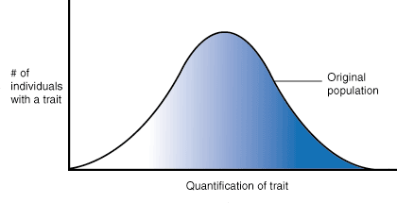
Normal Distribution

Slide 111
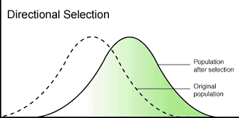
Directional Selection
When genes code for diseases that reduce ability to reproduce we see a different kind of distribution – we start seeing LESS of the disease allele and more of the normal alleles

Slide 112
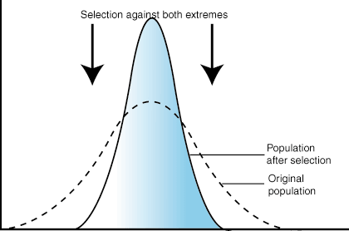
Stabilizing Selection
The strange thing about sickle cell anemia is that the disease alleles don’t seem to be going away
Something seems to be selecting AGAINST the healthy allele as well
?????????????????

Slide 113
What is going on!?
Can you think of any factors that might make this disorder so common in some populations? Why are some people more at risk than others?
If not, what are some things we could study to get an answer to this question?

Slide 114
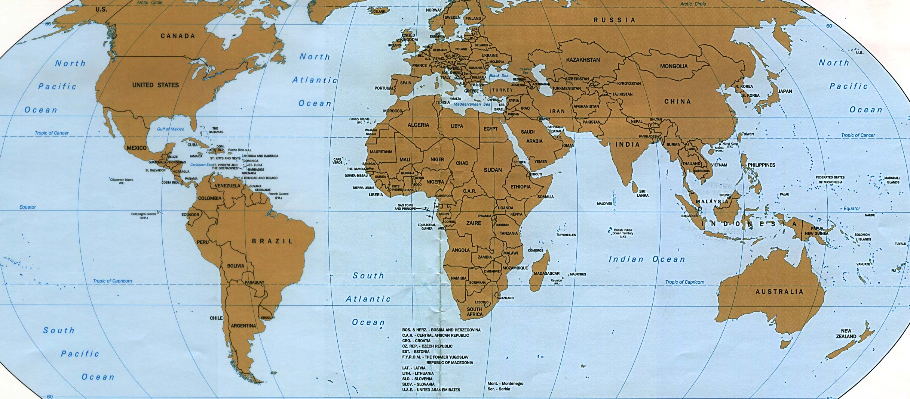

Slide 115
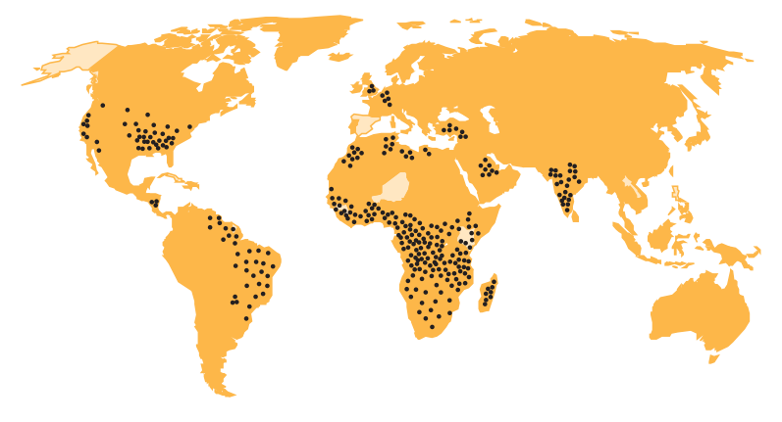
Global Prevalence of Sickle Cell

Slide 116
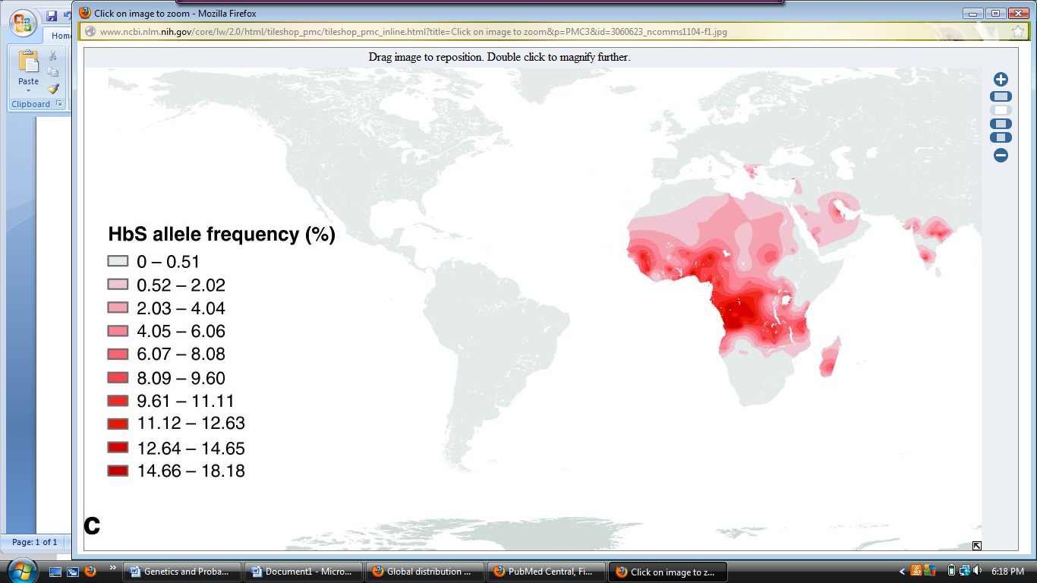
Sickle Cell Alleles

Slide 117
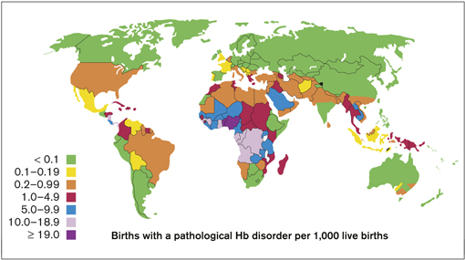

Slide 118
What can we observe about the regions with high levels of sickle cell?
What do these areas have that other regions do not?

Slide 119
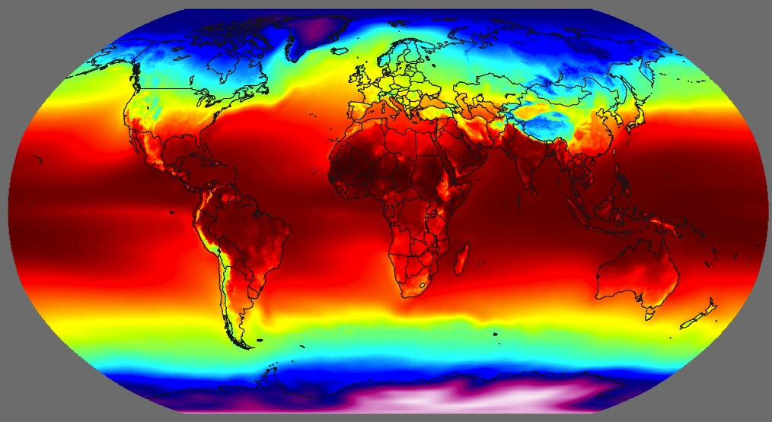
Average Temps. Of the World

Slide 120
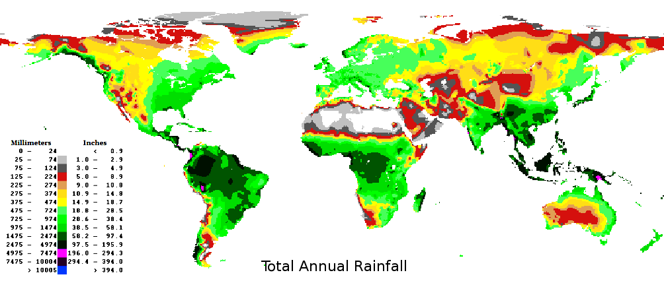

Slide 121
What can we observe about the regions with high levels of sickle cell?
What do these areas have that other regions do not?
Sickle Cell

Slide 122
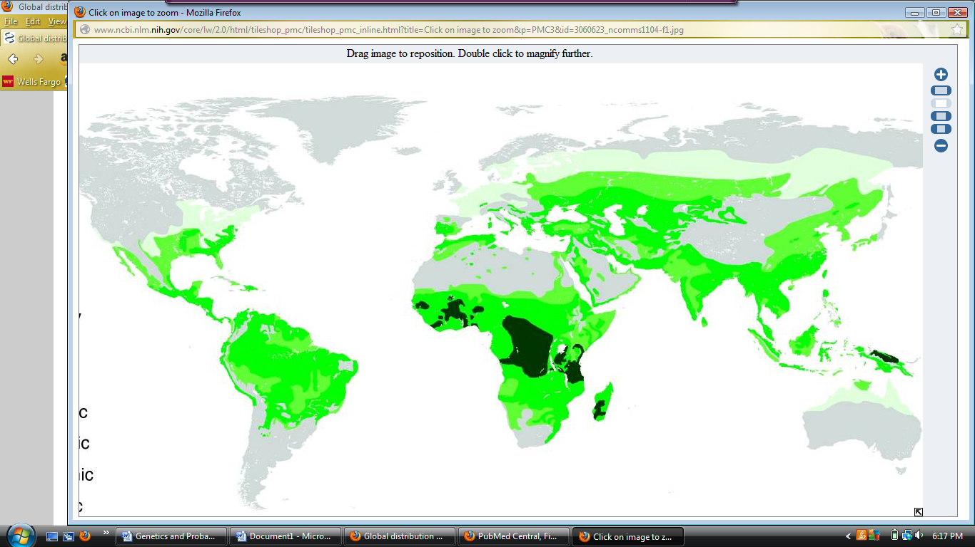
Malaria Cases

Slide 123
Malaria
Affects 5% of the world population at any given time
35,000,000 people!
Results in 500,000 – 2.5 million deaths per year
People can develop resistance to malaria if they can survive the initial infection
Most deaths are children without a resistance to the disease

Slide 124
Malaria Parasite
Caused by a parasite carried by mosquitoes abundant in tropical areas
There are 4 types of this parasite, the most serious is Plasmodium falciparum
Others are P. vivax, P. ovale, P. malariae and P. knowlesi.
Once inside the body, the parasite enters the liver to begin reproducing

Slide 125
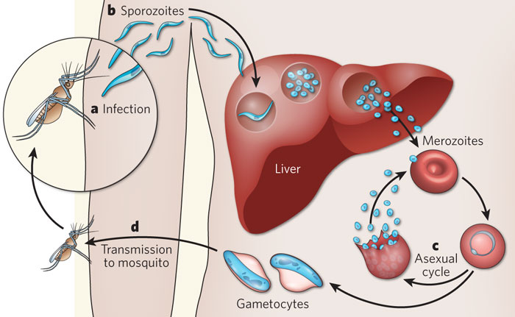

Slide 126
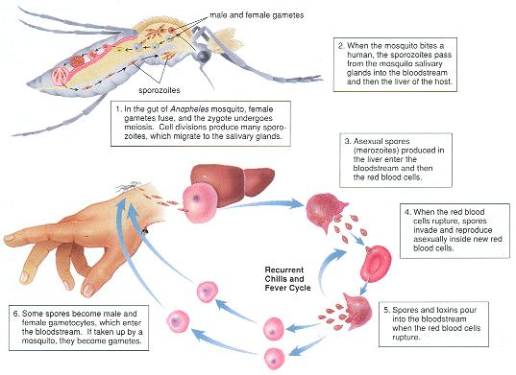

Slide 127
Sickle cell vs. Malaria
In people with sickle cell

Slide 128
Conclusion: How did this disease become so prevalent in certain populations?
Use what you have learned to answer this question. Be as specific as possible.

